Slide 1
Congruency and similarity review
EQ: How do we prove congruence and similiarity in triangles?

Slide 2
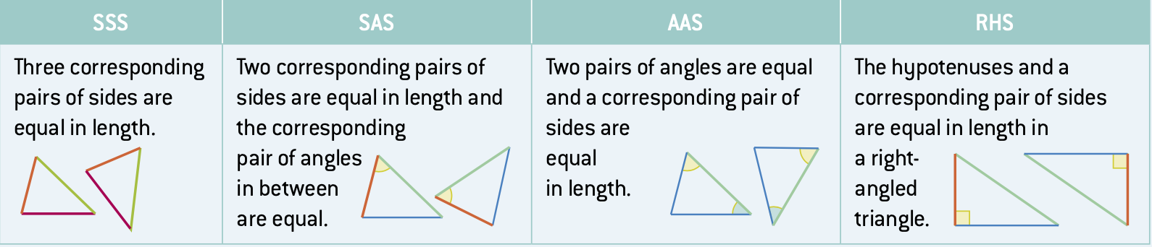

Topic: Congruency and similarity review
EQ: How can we determine congruency in triangles
To review, these are the following tests for congruency:
The symbols for congruency are: $≅$ or $≡$
We can get caught up on the notation for proving congruence and similarity, so let’s look at some examples

Slide 3
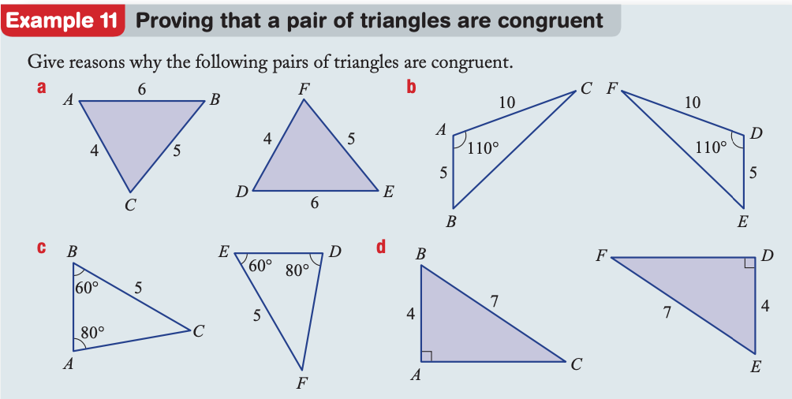

Slide 4
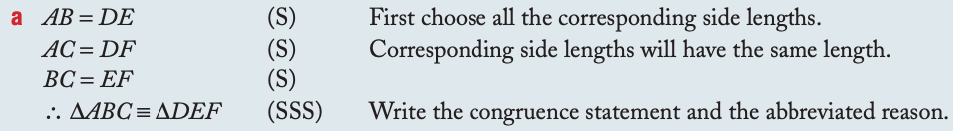
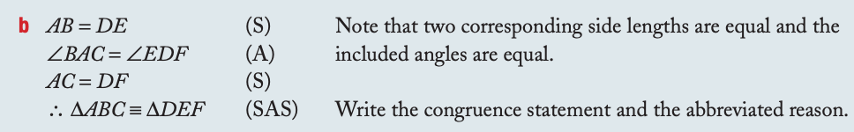

Slide 5
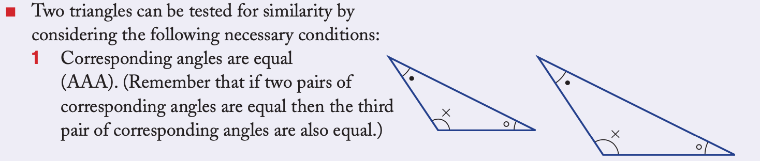
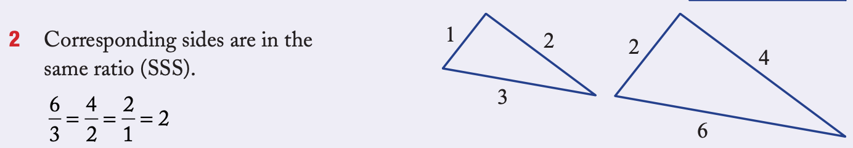
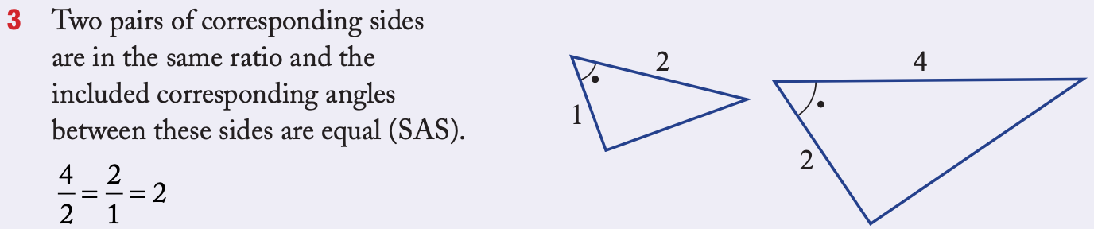
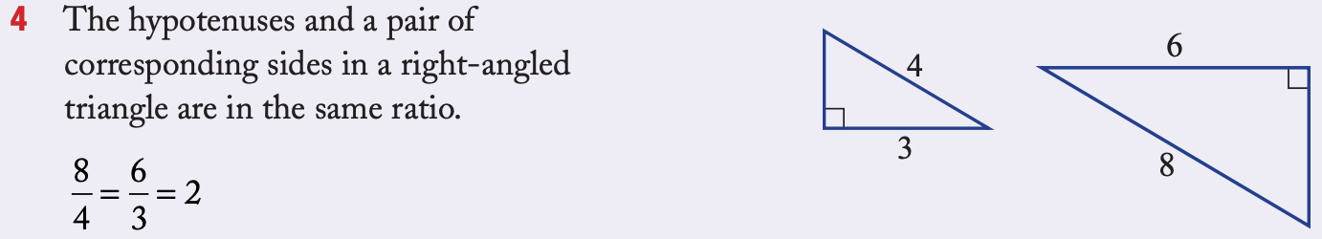
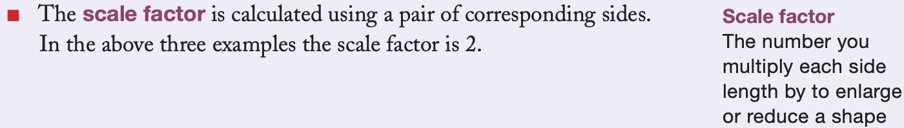

To review, these are the following tests for similarity:
The symbols for similarity is: $\sim$

Slide 6
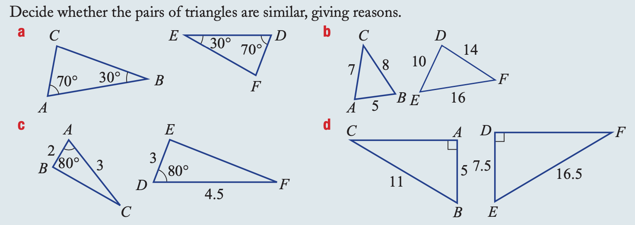

Slide 7
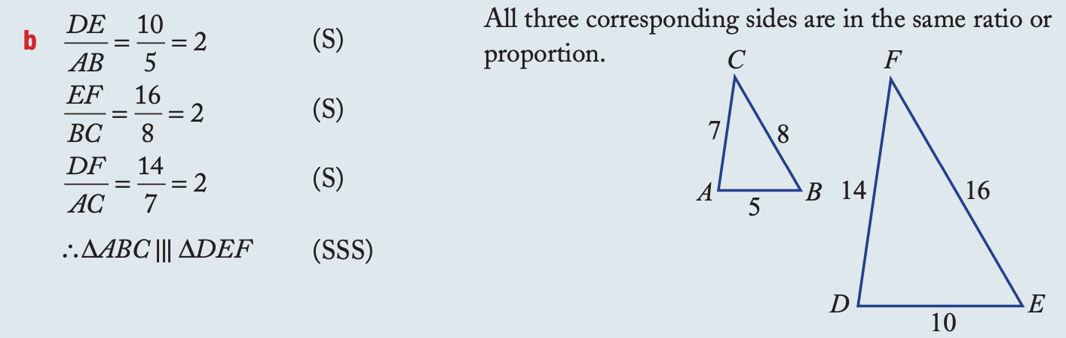
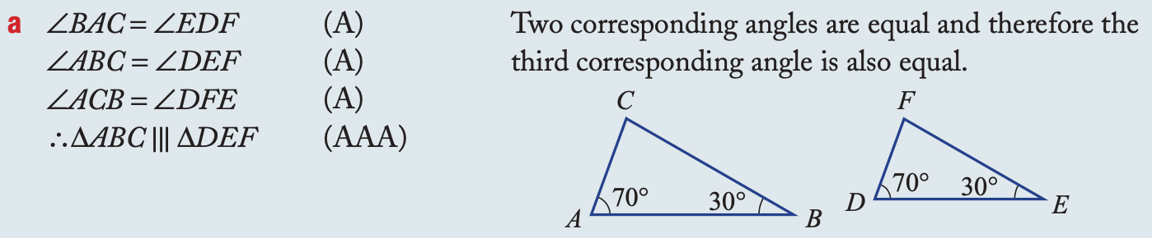

Slide 8
Complete Worksheet for Homework

